Slide 1
Discrete Probability Distributions
Shovan Bhowmik
Lecturer
Dept. Of CSE, BAIust

Slide 2
Binomial Distribution
Many statistical problems deal with the situations with repeated trials.
Flip a coin 10 times. Let X = number of heads obtained.
A worn machine tool produces 1% defective parts. Let X = number of defective parts in the next 25 parts produced.
A multiple-choice test contains 10 questions, each with four choices and you guess at each question. Let X = the number of questions answered correctly.
In each of these examples we are interested in the probability of getting X successes in n trials.
We can say this process of getting outcomes(Success or Failure) as Barnoulli’s Process.

Slide 3
Binomial Distribution(Cont..)
Barnoulli Process must possess the following properties:
The experiment consists of repeated trials.
Each trial results in an outcome that may be classified as a success or a failure.
The probability of success, denoted by p, remains constant from trial to trial.
The repeated trials are independent.
The number X of successes in n Bernoulli trials is called a binomial random variable.
The probability distribution of this discrete random variable is called the binomial distribution, and its values will be denoted by b(x; n, p)

Slide 4


Binomial Distribution(Cont..)
If X is a binomial random variable with parameters p and n, then mean and variance will be:
μ = E(X) = np and σ² = V (X)= np(1-p) = npq

Slide 5



Binomial Distribution(Cont..)
Each sample of water has a 10% chance of containing a particular organic pollutant. Assume that the samples are independent with regard to the presence of the pollutant.
Find the probability that in the next 18 samples, exactly 2 contain the pollutant.
Determine the probability that at least four samples contain the pollutant.
Solution: Here, n = 18 and p = 0.1
2.
Or
1.

Slide 6
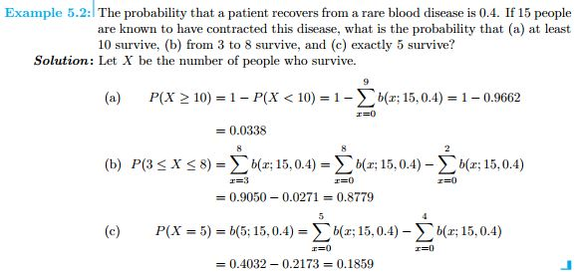
Binomial Distribution(Cont..)

Slide 7
Binomial Distribution(Cont..)
An exciting computer game has released. Sixty percent of players complete all the levels. Thirty percent of them will then buy an advanced version of the game.
Among 15 users, what is the expected number of people who will buy the advanced version?
What is the probability that at least two people will buy it?
Solution:
1. Let X be the number of people (successes), among n = 15 users (trials), who will buy the advanced version of the game.
p = P {buy advanced} = P {buy advanced | complete all levels}
= P {complete all levels} = (0.30)(0.60) = 0.18.
Then we have, E(X) = np = (15)(0.18) = 2.7
2. Try it yourself

Slide 8

Negative Binomial Distribution
The number X of trials required to produce k successes in a negative binomial experiment is called a negative binomial random variable, and it’s probability distribution is called the negative binomial distribution.
If repeated independent trials can result in a success with probability p and a failure with probability q = 1-p, then the probability distribution of the random variable X, the number of the trial on which the kth success occurs is:
Mean and Variance of Negative Binomial Distribution is:

Slide 9
Negative Binomial Distribution(Cont..)
Consider the time to recharge the camera ﬂash. The probability that a camera passes the test is 0.8, and the cameras perform independently. What is the probability that the third failure is obtained in five or fewer tests?
Solution:
Let X denote the number of cameras tested until three failures have been obtained. The requested probability is P( X) ≤ 5. Here, X has a negative binomial distribution with p = 0.2 and k = 3.
Therefore,

Slide 10

Geometric Distribution
The number of Bernoulli trials needed to get the first success has Geometric distribution.
In a series of Bernoulli trials (independent trials with constant probability p of a success), the random variable X that equals the number of trials until the first success is a geometric random variable with parameter 0 < p < 1
When k = 1, the negative binomial reduces to the geometric distribution.
g(x; p) = (1-p)^{x-1}p = pq^{x−1}, q= 1-p, x = 1, 2, 3, . . . .
Mean and Variance of Negative Binomial Distribution is:

Slide 11
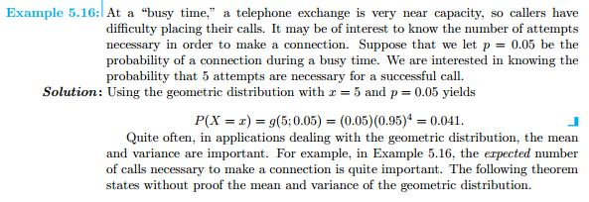
Geometric Distribution(Cont..)

Slide 12
Poisson Distribution(Cont..)
Experiments yielding numerical values of a random variable X, the number of outcomes occurring during a given time interval or in a specified region, are called Poisson experiments.
The given time interval may be of any length, such as a minute, a day, a week, a month, or even a year.
For example:
Number of messages arriving at a telecommunications system in a day
Number of flaws in a meter of fiber optic cable
Number of radio-active particles detected in a given time
Number of errors in software

Slide 13
Poisson Distribution(Cont..)
Poisson Process Properties:
The number of outcomes occurring in one time interval / region of space is independent that occur in any other disjoint time interval or region.
The probability that a single outcome will occur during a very short time interval or in a small region is proportional to the length of the time interval or the size of the region.
The probability that more than one outcome will occur in such a short time interval or fall in such a small region is negligible.

Slide 14


Poisson Distribution(Cont..)
If events happen independently of each other, with 𝜆= average number of events in some fixed interval, then the distribution of the number of events in that interval is Poisson.
A Poisson random variable 𝑋 with parameter 𝜆 > 0 has the distribution
If X is a Poisson random variable in a given interval t with parameter 𝜆 > 0 has the distribution

Slide 15
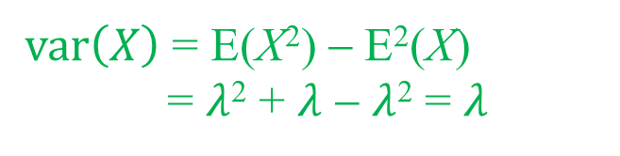

Poisson Distribution(Cont..)
Mean and Variance of Poisson Distribution:
If X is a poisson random variable with parameter $λ$, then:
$μ=E\left(X\right)=λ$ $σ^{2}=var\left(X\right)=λ$
Proof:
$var\left(X\right)$ = E(X²) − E²(X)
= $λ$² + $λ$ − $λ$² = $λ$

Slide 16
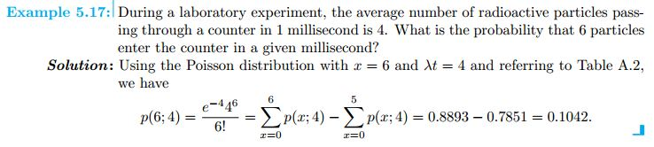
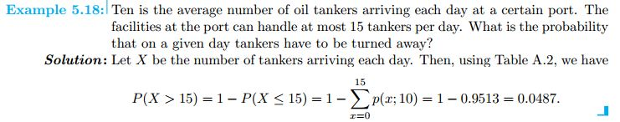
Poisson Distribution(Cont..)

Slide 17

Poisson Approximation to Binomial Distribution
Poisson distribution can be effectively used to approximate Binomial probabilities when the number of trials n is large, and the probability of success p is small.
Such an approximation is adequate, say, for n ≥ 30 and p ≤ 0.05, and it becomes more accurate for larger n.

Slide 18
Poisson Approximation to Binomial Distribution(Cont..)
Eg: Suppose there are n = 400, 000 potential internet users in the area, and on any specific day, each of them opens a new account with probability p = 0.000025.
We see that the number of new accounts is the number of successes, hence a Binomial model with expectation E(X) = np = 10 is possible.
Instead, one can use Poisson distribution with the same expectation λ = 10.

Slide 19
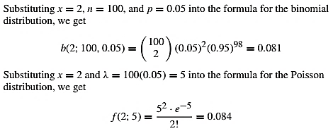
Poisson Approximation to Binomial Distribution(Cont..)
It is known that 5% of the books bound at a certain bindery have defective bindings. Find the probability that 2 of 100 books bound by this bindery will have defective bindings using.
Solution:

Slide 20

Poisson Approximation to Binomial Distribution(Cont..)
Ninety-seven percent of electronic messages are transmitted with no error. What is the probability that out of 200 messages, at least 195 will be transmitted correctly?
Solution:
Let X be the number of correctly transmitted messages. It is the number of successes in 200 Bernoulli trials, thus X is Binomial with n = 200 and p = 0.97.
Poisson approximation cannot be applied to X because p is too large.
However, the number of failures Y is also Binomial, with parameters n = 200 and q = 0.03, and it is approximately Poisson with λ = nq = 6.

Slide 21
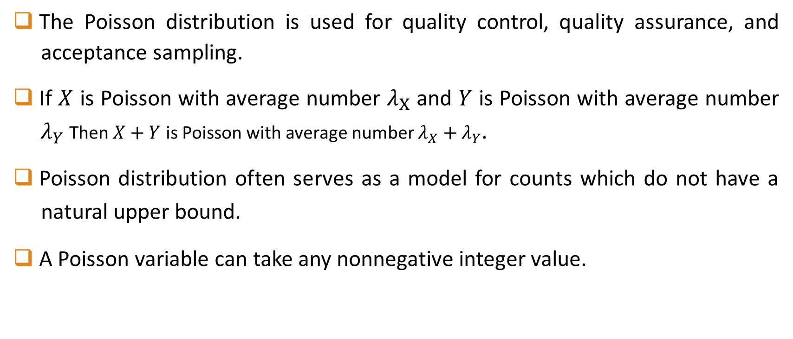
Poisson Distribution(Extras)
The Poisson distribution is used for quality control, quality assurance, and acceptance sampling.
If $X$ is Poisson with average number $λ_{X}$ and $Y$ is Poisson with average number ${ λ}_{Y}$Then $X+Y$ is Poisson with average number $λ_{X}+λ_{Y}$.
Poisson distribution often serves as a model for counts which do not have a natural upper bound.
A Poisson variable can take any nonnegative integer value.

Slide 22
Math Problems needed to solve
Walpole Book:
Example: 5.3, 5.4, 5.5, 5.6, 5.14, 5.15, 5.16, 5.17, 5.18, 5.19
Exercises: 5.4, 5.7, 5.10, 5.15, 5.27, 5.52, 5.55, 5.60, 5.61, 5.62, 5.65, 5.66, 5.67, 5.73, 5.75, 5.76
Slide Math

Slide 23
References
Probability and Statistics for Engineers and Scientists(9th Edition) – Walpole
Probability and Statistics for Engineers and Scientists(4th Edition) – Sheldon Ross
Internet Resources

Slide 24


